Slide 1
NETWORK SIMULATION
Mininet python API to create custom topology
Number of nodes - N input parameter
Initially , k operational nodes
Dynamic Node

Slide 2
NODE STRUCTURE
Each node - xterm terminal running java implementation of the assignment
Communication among nodes using sockets
Threads to handle different component functionalities

Slide 3
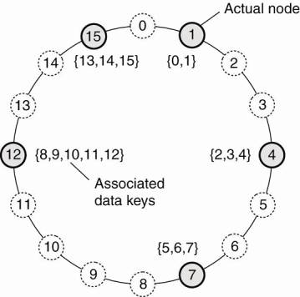
DISTRIBUTED HASH TABLE
Chord DHT algorithm
Simple & Elegant
Keys are distributed uniformly (consistent hashing)
SHA-1 for consistent hashing
Public keys are added implicitly ,retrieved through user interface

Slide 4
TWO PHASE COMMIT PROTOCOL
Sender creates the transaction and sends it to the witness and the receiver
Two Phase Commit thread to communicate with the receiver and the witness
Two Phase Commit Handler to communicate with the sender

Slide 5
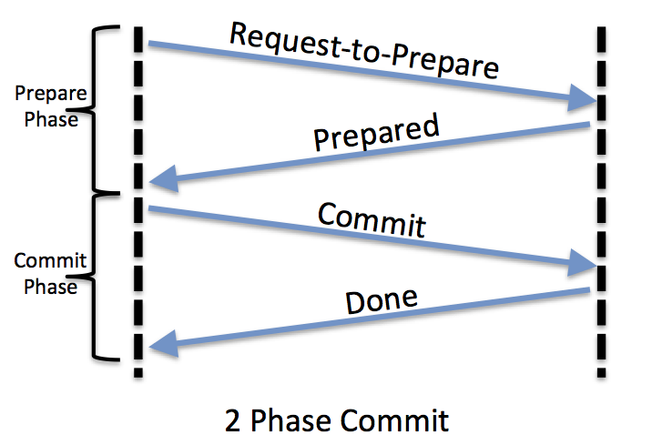
TWO PHASE COMMIT PROTOCOL

Slide 6
STRUCTURE OF TRANSACTION
Transaction Id of type long
Node Id of type int
Receiver of type string, we store the receiver account number in this object
Witness of type string, we store the witness account number in this object
Sender of type string, we store the sender account number in this object

Slide 7
STRUCTURE OF TRANSACTION
In Counter of type int. This variable stores the number of previous transactions referred to make this transaction. The previous transactions referred is also called input transaction
Input List of type Input, here Input is a user defined class. As in bitcoin network, we represent an input transaction using the previous transaction id and along with that we append a script Sig

Slide 8
STRUCTURE OF TRANSACTION
Out Counter of type int
Out List of type Output, here Output is a user defined class used to represent an output of the transaction.
Coin Base of type Boolean
coin Base is set to true only for the transactions which are added initially when the network is started.

Slide 9
ATOMIC GLOBAL ORDER BROADCAST
Broadcasting through communication on UDP sockets
ABCAST multicast protocol (RFC 992) implemented to achieve global ordering
A sequence of exchanges among nodes that leads to a global consensus on timestamps given to transactions

Slide 10
ABCAST
C
B
17
23
31
25
E
23
A
21
23
23
D
Here initial estimate is 23.
Transaction will be assignment timestamp = max(23,17,31,25,21)=31
Transactions are then placed in transaction list in this global timestamp order.

